Slide 1

THE TRANSFORMATION GAP SUMMIT
Become part of real
transformation.
PARTNERSHIP OPPORTUNITIES
A practical partnership platform for category leadership, qualified audience access, measurable action and long-term brand value.
SEPTEMBER 24–29, 2026
Global virtual summit · Hosted by Suffer to Tougher
Notes:
[Sources]
- User-supplied event, audience and sponsorship information; owned Transformation Gap Summit brand assets.

Slide 2
THE PROBLEM
People do not need
more information.
They need a bridge between what they understand and what they can consistently live.
That bridge is the Transformation Gap—and it creates a powerful, relevant role for the right partners.
THE TRANSFORMATION GAP SUMMIT · PARTNERSHIP OPPORTUNITIES
02
Notes:
[Sources]
- User-supplied summit positioning; generated bridge visual is an owned production asset.

Slide 3
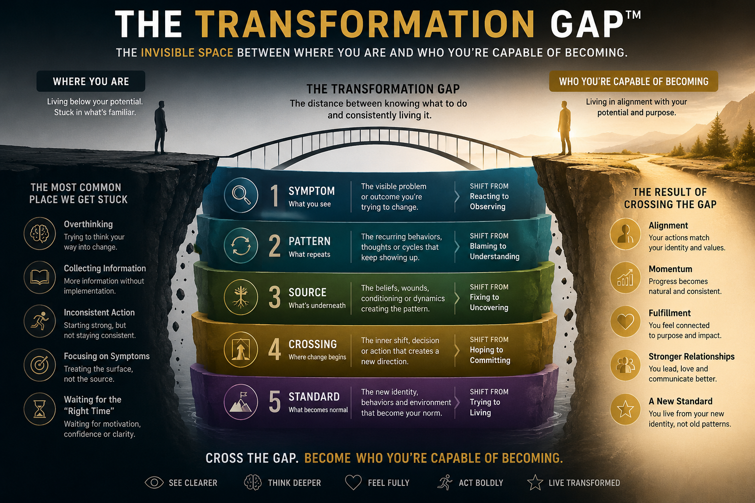
THE EVENT
A six-day global experience built for real-world transformation.
5,000+
6
6
Targeted global registrants
Days of expert conversations
Connected transformation lenses
Virtual · Prerecorded · Practical · Globally accessible
Free attendee resources, VIP implementation programs and a first-of-its-kind AI Transformation Gap Guide extend the experience beyond the event.
THE TRANSFORMATION GAP SUMMIT · PARTNERSHIP OPPORTUNITIES
03
Notes:
[Sources]
- User-supplied event, audience and sponsorship information; owned Transformation Gap Summit brand assets.

Slide 4


HOSTED BY SUFFER TO TOUGHER
A human conversation about what change really requires.
The hosts bring the Suffer to Tougher mission into a curated conversation with researchers, authors, coaches, practitioners and people who have lived transformation firsthand.
The result: a summit grounded in credibility, lived experience and practical next steps—not surface-level motivation.
Kelsey Dunbar
Marc Rogala
THE TRANSFORMATION GAP SUMMIT · PARTNERSHIP OPPORTUNITIES
04
Notes:
[Sources]
- User-supplied event, audience and sponsorship information; owned Transformation Gap Summit brand assets.

Slide 5

ONE AUDIENCE. SIX ENTRY POINTS.
Transformation is not one-dimensional.
01
Identity & Inner Transformation
02
Behavior, Habits & Rewiring
03
Body, Health & Performance
04
Life, Relationships & Expression
05
Business Transformation
06
Guides of Transformation
Each lens creates a credible sponsorship pathway aligned with a distinct attendee need.
THE TRANSFORMATION GAP SUMMIT · PARTNERSHIP OPPORTUNITIES
05
Notes:
[Sources]
- User-supplied six-lens framework; generated six-lenses visual is an owned production asset.

Slide 6
THE FRAMEWORK
Partners can support the entire crossing—not just one moment of attention.
Symptom → Pattern → Source → Crossing → Standard
Notes:
[Sources]
- User-supplied event, audience and sponsorship information; owned Transformation Gap Summit brand assets.

Slide 7
THE PARTNERSHIP PROPOSITION
Turn the summit into a business outcome—not a logo placement.
01
02
03
04
QUALIFIED
AUTHORITY
ACTION
EVERGREEN
Reach a self-selecting audience actively seeking meaningful change.
Build credibility beside trusted experts by helping attendees make progress.
Create consent-based opt-ins, trials, product discovery and next steps.
Extend value through reusable content, VIP, replays and implementation.
THE TRANSFORMATION GAP SUMMIT · PARTNERSHIP OPPORTUNITIES
07
Notes:
[Sources]
- User-supplied event, audience and sponsorship information; owned Transformation Gap Summit brand assets.

Slide 8
A COMPLETE INTEGRATION ECOSYSTEM
Your brand can create value at every stage of the audience journey.
DISCOVERY
AUTHORITY
ACTIVATION
Earn attention before the event begins
Expert education, track ownership and host integration
Assessment, resource, trial or product experience
CONVERSION
CONTINUATION
INSIGHT
Consent-based next steps and lifetime value
Governed, contextual post-summit support
Reporting, reusable content and next opportunity
THE TRANSFORMATION GAP SUMMIT · PARTNERSHIP OPPORTUNITIES
08
Notes:
[Sources]
- User-supplied event, audience and sponsorship information; owned Transformation Gap Summit brand assets.

Slide 9
01 · FLAGSHIP PARTNERSHIP
$12,500
Presenting Transformation Partner
ONE AVAILABLE
• Summit-wide presenting designation
• Primary registration, programming, VIP and replay placement
• Category exclusivity and daily host recognition
• Dedicated pre- and post-summit email
• Featured profile with consent-based CTA
• Hosted 20–30-minute educational conversation
• Resource, assessment, trial or product experience
• Selected email and host-read integrations
• Reusable approved content assets
• Six social acknowledgments
• Eight VIP passes
• Full-funnel performance report
Best for category leadership, qualified market access, measurable action and long-term brand position.
THE TRANSFORMATION GAP SUMMIT · PARTNERSHIP OPPORTUNITIES
09
Notes:
[Sources]
- User-supplied event, audience and sponsorship information; owned Transformation Gap Summit brand assets.

Slide 10
02 · HIGH-VISIBILITY PARTNERSHIP
$6,000
Transformation Impact Partner
TWO AVAILABLE
Qualified audience access
Authority through usefulness
Measurable brand action
Prominent registration, programming, VIP and replay visibility across the attendee journey.
A dedicated feature plus an approved 15–20-minute educational conversation.
A consent-based resource, assessment, trial or offer supported by placement and reporting.
Also includes four social acknowledgments, four VIP passes, reusable assets and a promotional toolkit.
Notes:
[Sources]
- User-supplied event, audience and sponsorship information; owned Transformation Gap Summit brand assets.

Slide 11
03 · OWN A TRANSFORMATION LENS
Six-Lens Track Partner
$3,500
One primary partner per lens
• Track-page positioning
• Recognition in track introduction
• Inclusion in track emails
• Useful sponsor resource or opt-in
• 60–90-second educational message
• Two social acknowledgments
• Two VIP passes
• Track-level reporting
THE TRANSFORMATION GAP SUMMIT · PARTNERSHIP OPPORTUNITIES
11
Notes:
[Sources]
- User-supplied package facts; generated six-lenses visual is an owned production asset.

Slide 12
ACCESSIBLE PARTNERSHIP PATHWAYS
Practical ways to contribute without requiring summit-wide ownership.
Implementation Partner
Community Partner
$2,000
$1,000
Resource-center placement
Implementation-email inclusion
Approved resource, trial or discount
Workbook or program placement
One social acknowledgment
Two VIP passes + basic reporting
Partner-page recognition
One useful attendee benefit
Collective community-partner feature
One social acknowledgment
One VIP pass
Partner promotional toolkit
THE TRANSFORMATION GAP SUMMIT · PARTNERSHIP OPPORTUNITIES
12
Notes:
[Sources]
- User-supplied event, audience and sponsorship information; owned Transformation Gap Summit brand assets.

Slide 13

SPECIAL ACTIVATIONS
Support the parts attendees will keep using.
AI Transformation Gap Guide Founding Partner
$7,500+
All AI integrations are governed: sponsors receive acknowledgment and contextual placement—not access to private conversations or control over recommendations.
Transformation Gap Diagnostic Partner
$3,500
VIP Implementation Partner
$3,500
Three-Resource Starter Kit Partner
$2,500
THE TRANSFORMATION GAP SUMMIT · PARTNERSHIP OPPORTUNITIES
13
Notes:
[Sources]
- User-supplied activation pricing and AI governance terms; generated AI Guide visual is an owned production asset.

Slide 14
MEASUREMENT
Know the difference between exposure, engagement and action.
01
02
03
04
REACH
ENGAGEMENT
ACTION
LONGEVITY
Registrations, geography and email delivery
Opens, clicks, track views and resource downloads
Lead opt-ins, trial starts and attributable conversions
VIP, replay and post-summit engagement
Every partner receives reporting appropriate to its tier. No attendee data is transferred without explicit consent.
Notes:
[Sources]
- User-supplied event, audience and sponsorship information; owned Transformation Gap Summit brand assets.

Slide 15
A SIMPLE PATH FROM ALIGNMENT TO ACTIVATION
We build the partnership around relevance, usefulness and measurable delivery.
01
02
03
04
05
ALIGN
DESIGN
BUILD
ACTIVATE
REPORT
Choose the audience need, lens and business objective.
Select the package, resource, message and CTA.
Create, approve and test the integration.
Promote before, during and after the summit.
Review results and identify the next opportunity.
Assets, tracking links and approvals are finalized before launch; partner reporting follows within 14 days after the summit.
THE TRANSFORMATION GAP SUMMIT · PARTNERSHIP OPPORTUNITIES
15
Notes:
[Sources]
- User-supplied event, audience and sponsorship information; owned Transformation Gap Summit brand assets.

Slide 16
FOUNDING PARTNERSHIP OPPORTUNITIES
Choose the level that matches your desired reach, integration and ownership.
PARTNERSHIP
INVESTMENT
AVAILABLE
Presenting Transformation Partner
$12,500
1
Transformation Impact Partner
$6,000
2
Six-Lens Track Partner
$3,500
6
Implementation Partner
$2,000
4
Community Partner
$1,000
Limited
THE TRANSFORMATION GAP SUMMIT · PARTNERSHIP OPPORTUNITIES
16
Notes:
[Sources]
- User-supplied event, audience and sponsorship information; owned Transformation Gap Summit brand assets.

Slide 17
THE NEXT STEP
Help thousands of people
turn insight into action.
Let’s design a partnership that is useful to attendees, aligned with your brand and measurable after the summit.
PARTNERSHIP CONVERSATIONS
thecatalyststage@gmail.com
transformation-gap-summit.onlinesleepcoach.chatgpt.site/sponsors
Notes:
[Sources]
- User-supplied event and partnership information; generated bridge visual is an owned production asset.

